Slide 1
Trees
Data Structures and Algorithm

Slide 2
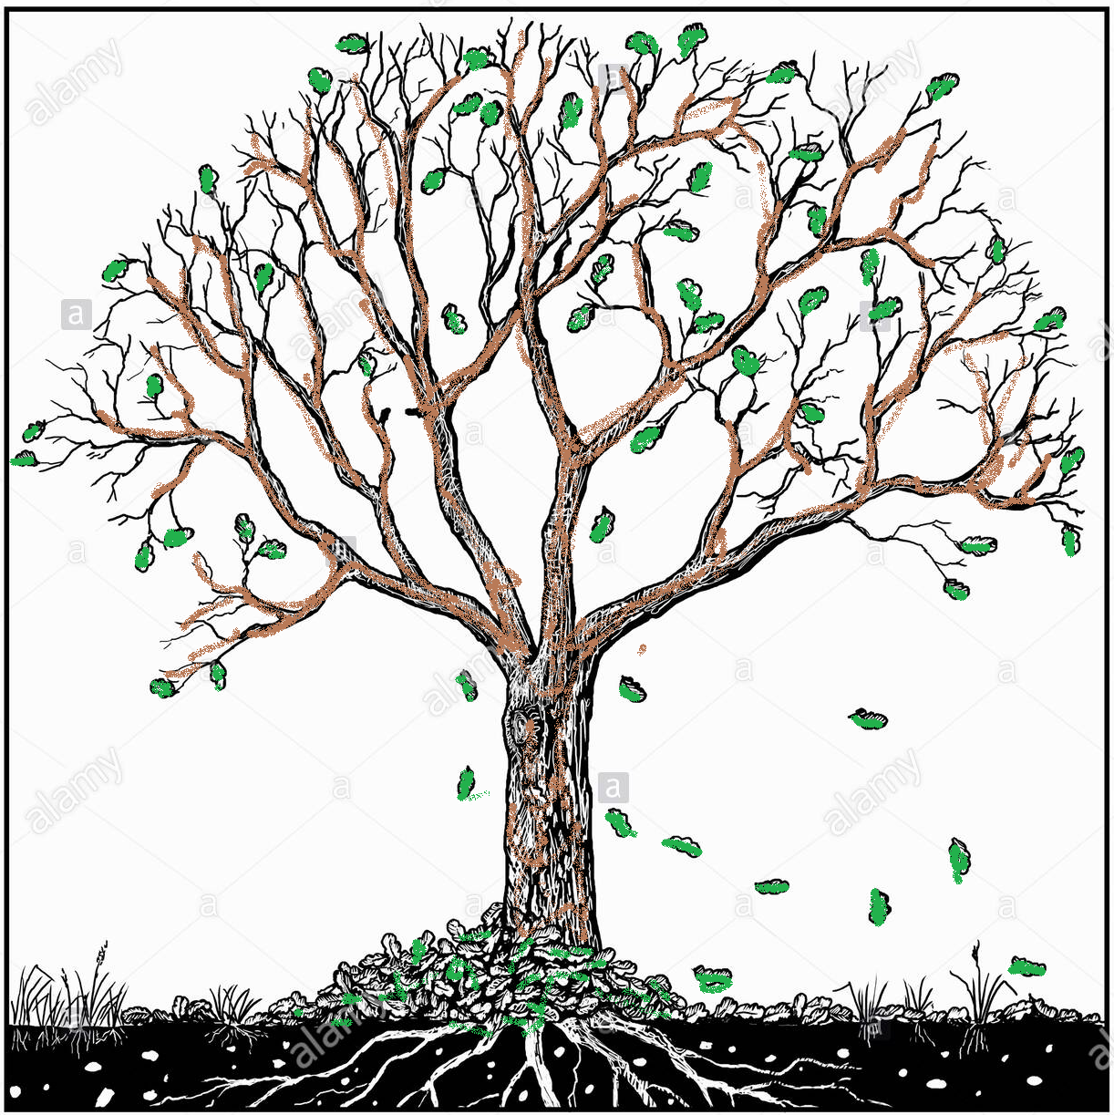
Trees
Siblings
Depth
Degree of node
Internal node
Leaf node
Successor node
Height
Children
Path
Parent node
Ancestor
Descendant
Root

Slide 3
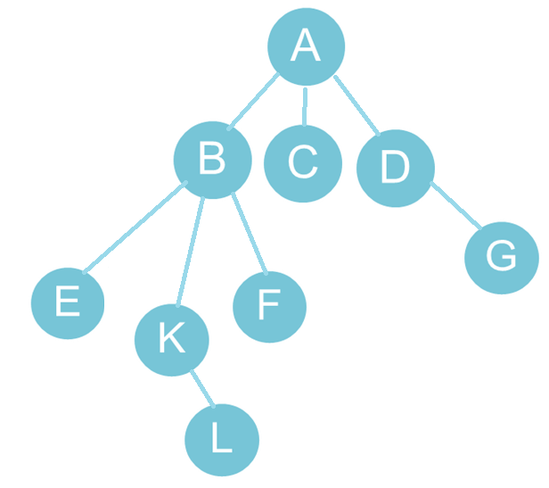
Trees
Extend the concept of linked data structure to a structure that may have multiple relations among its nodes Such a structure is called a tree.
A tree is a collection of nodes connected by directed (or undirected) edges.
A tree can be empty with no nodes or a tree is a structure consisting of one node called the root and zero or one or more sub trees. A tree has following general properties:
One node is distinguished as a root;
Every node (exclude a root) is connected by a directed edge from exactly one other node; A direction is: parent -> children
A is a parent of B, C, D, B is called a child of A. on the other hand, B is a parent of E, F, K
In the given picture, the root has 3 subtrees.

Slide 4
Advantages of Trees
Trees are so useful and frequently used, because they have some very serious advantages:
Trees reflect structural relationships in the data.
Trees are used to represent hierarchies.
Trees provide an efficient insertion and searching.
Trees are very flexible data, allowing to move subtrees around with minumum effort.

Slide 5
Trees
A rooted tree data structure stores information in nodes
Similar to linked lists:
There is a first node, or root
Each node has variable number of references to successors
Each node, other than the root, has exactly one node pointing to it
All nodes will have zero or more child nodes or children
For all nodes other than the root node, there is one parent node

Slide 6
Trees
Each node can have arbitrary number of children. Nodes with no children are called leaves, or external nodes. In the above picture, C, E, F, L, G are leaves. Nodes, which are not leaves, are called internal nodes. Internal nodes have at least one child.
Nodes with the same parent are called siblings. In the picture, B, C, D are called siblings. The depth of a node is the number of edges from the root to the node. The depth of K is 2. The height of a node is the number of edges from the node to the deepest leaf. The height of B is 2. The height of a tree is a height of a root from deepest node.
A is a parent of B, C, D, B is called a child of A. on the other hand, B is a parent of E, F, K

Slide 7
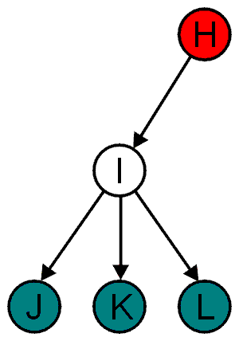
Trees
All nodes will have zero or more child nodes or children
I has three children: J, K and L
For all nodes other than the root node, there is one parent node
H is the parent
The degree of a node is defined as the number of its children: deg(I) = 3
Nodes with the same parent are siblings
J, K, and L are siblings

Slide 8
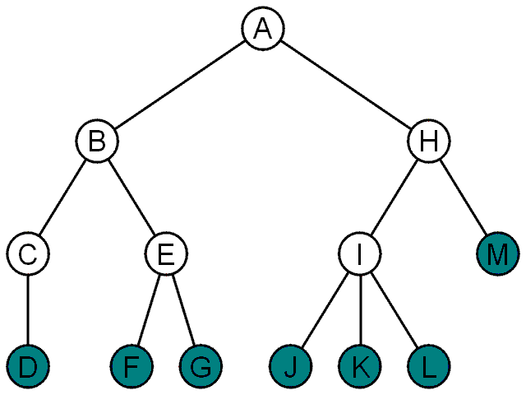
Trees
Nodes with degree zero are also called leaf nodes
All other nodes are said to be internal nodes, that is, they are internal to the tree

Slide 9
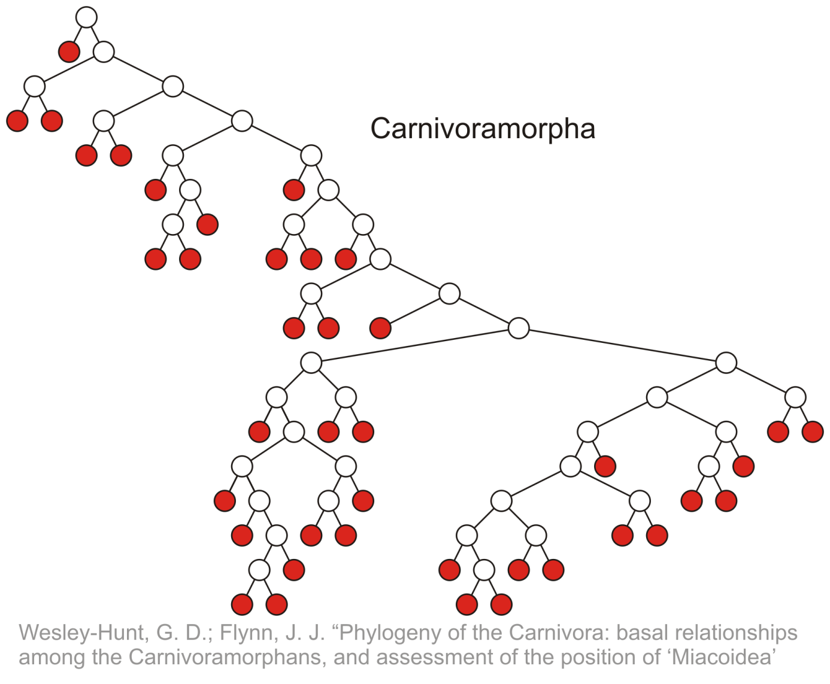
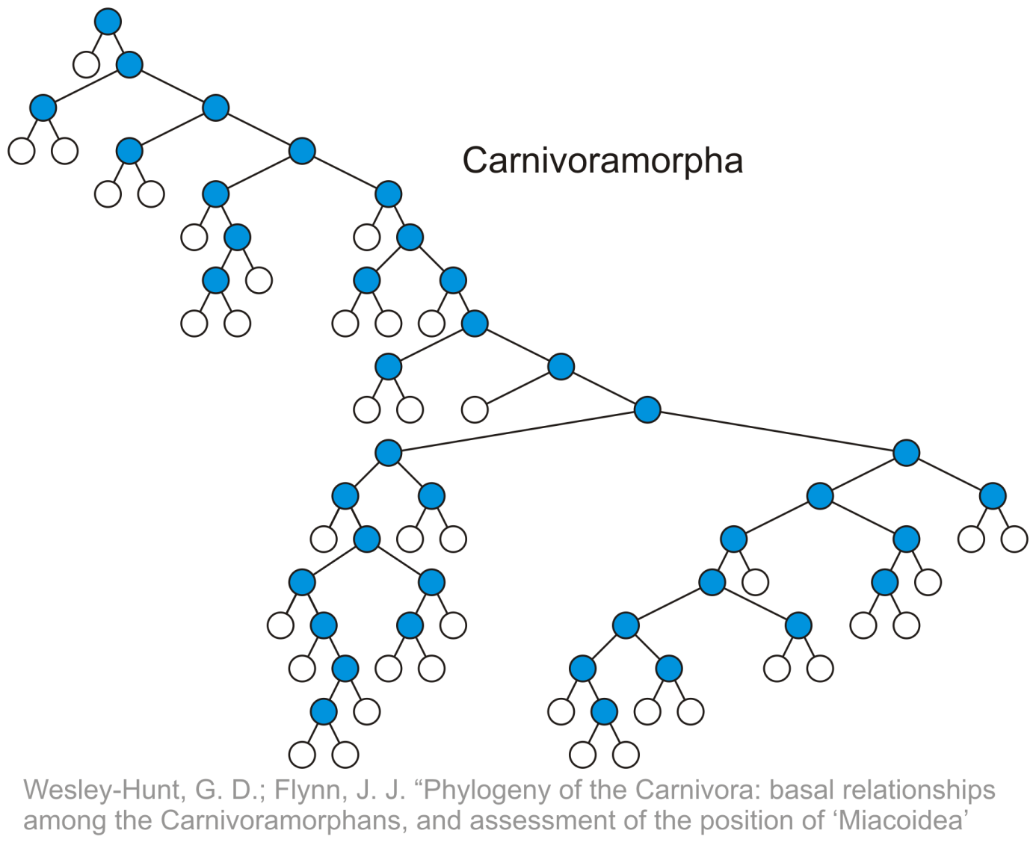
Tree
Leaf nodes:
Internal nodes:

Slide 10
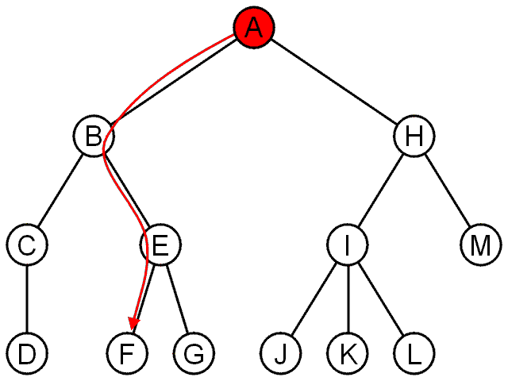
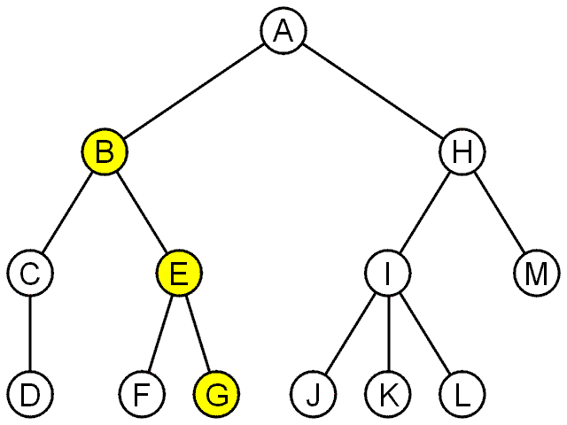
Trees
The shape of a rooted tree gives a natural flow from the root node, or just root
A path is a sequence of nodes
(a₀, a₁, ..., a_{n})
where a_{k + 1} is a child of a_{k} is
The length of this path is n
E.g., the path (B, E, G) has length 2

Slide 11
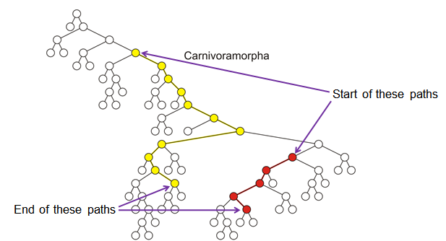
Trees
Paths of length 10 (11 nodes) and 4 (5 nodes)

Slide 12
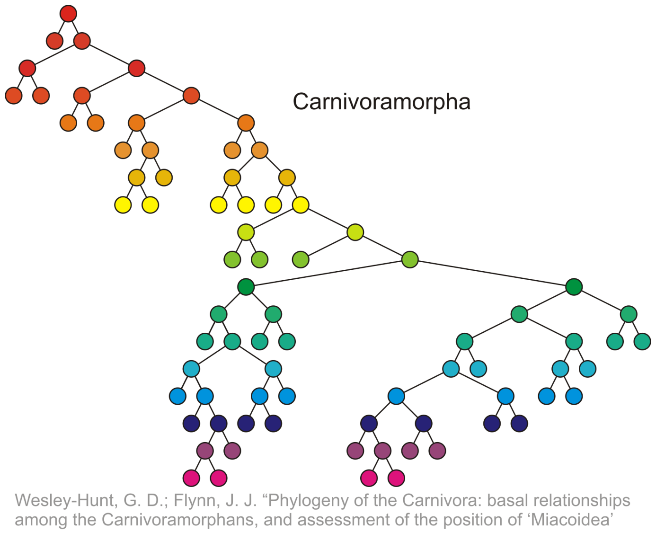
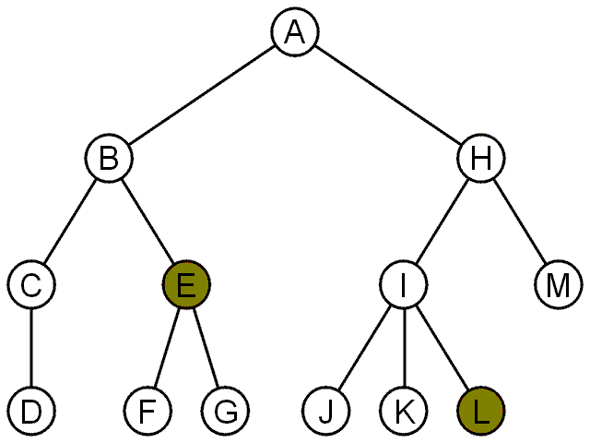
Trees
For each node in a tree, there exists a unique path from the root node to that node
The length of this path is the depth of the node, e.g.,
E has depth 2
L has depth 3
Nodes of depth up to 17
14
17

Slide 13
Trees
The height of this tree is 17
The height of a tree is defined as the maximum depth of any node within the tree
The height of a tree with one node is 0
Just the root node
For convenience, we define the height of the empty tree to be –1

Slide 14
Trees
If a path exists from node a to node b:
a is an ancestor of b
b is a descendent of a
Thus, a node is both an ancestor and a descendant of itself
We can add the adjective strict to exclude equality: a is a strict descendent of b if a is a descendant of b but a ≠ b
The root node is an ancestor of all nodes

Slide 15
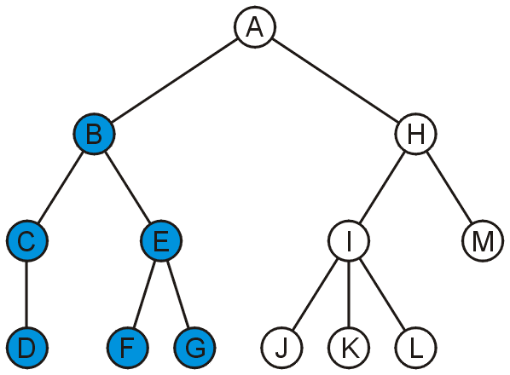
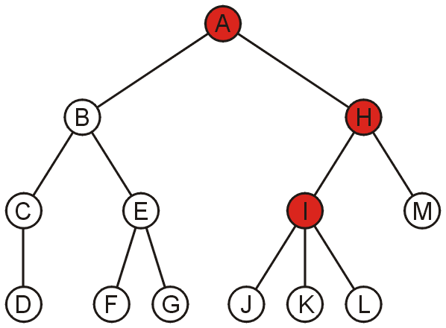
Trees
The descendants of node B are B, C, D, E, F, and G:
If a path exists from node a to node b:
a is an ancestor of b
b is a descendent of a
Thus, a node is both an ancestor and a descendant of itself
We can add the adjective strict to exclude equality: a is a strict descendent of b if a is a descendant of b but a ≠ b
The root node is an ancestor of all nodes
The ancestors of node I are I, H, and A:

Slide 16
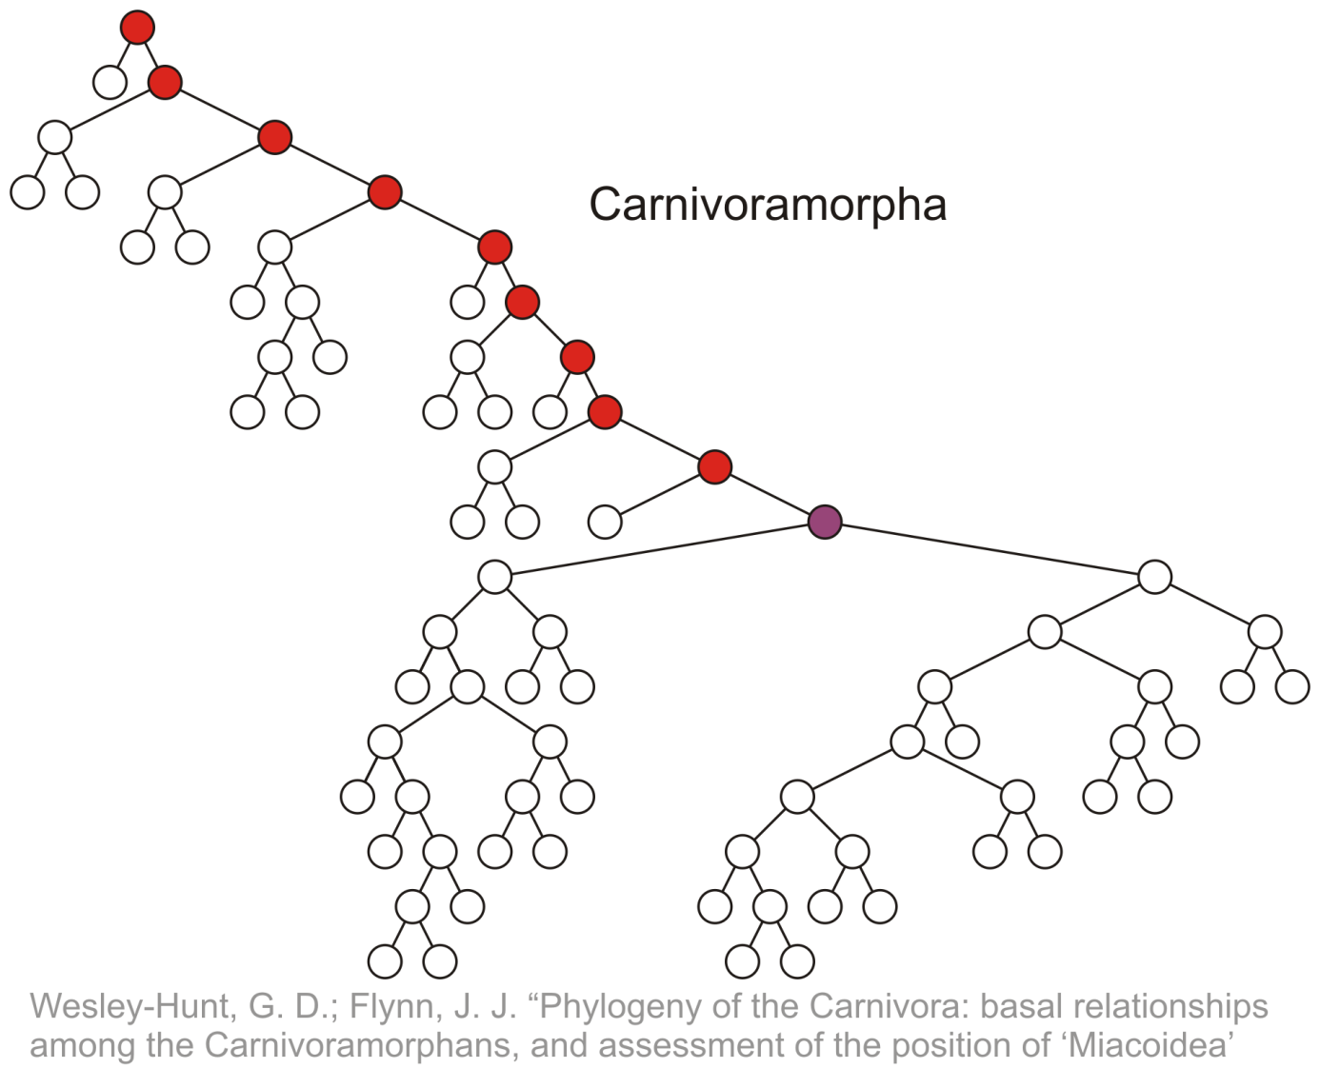
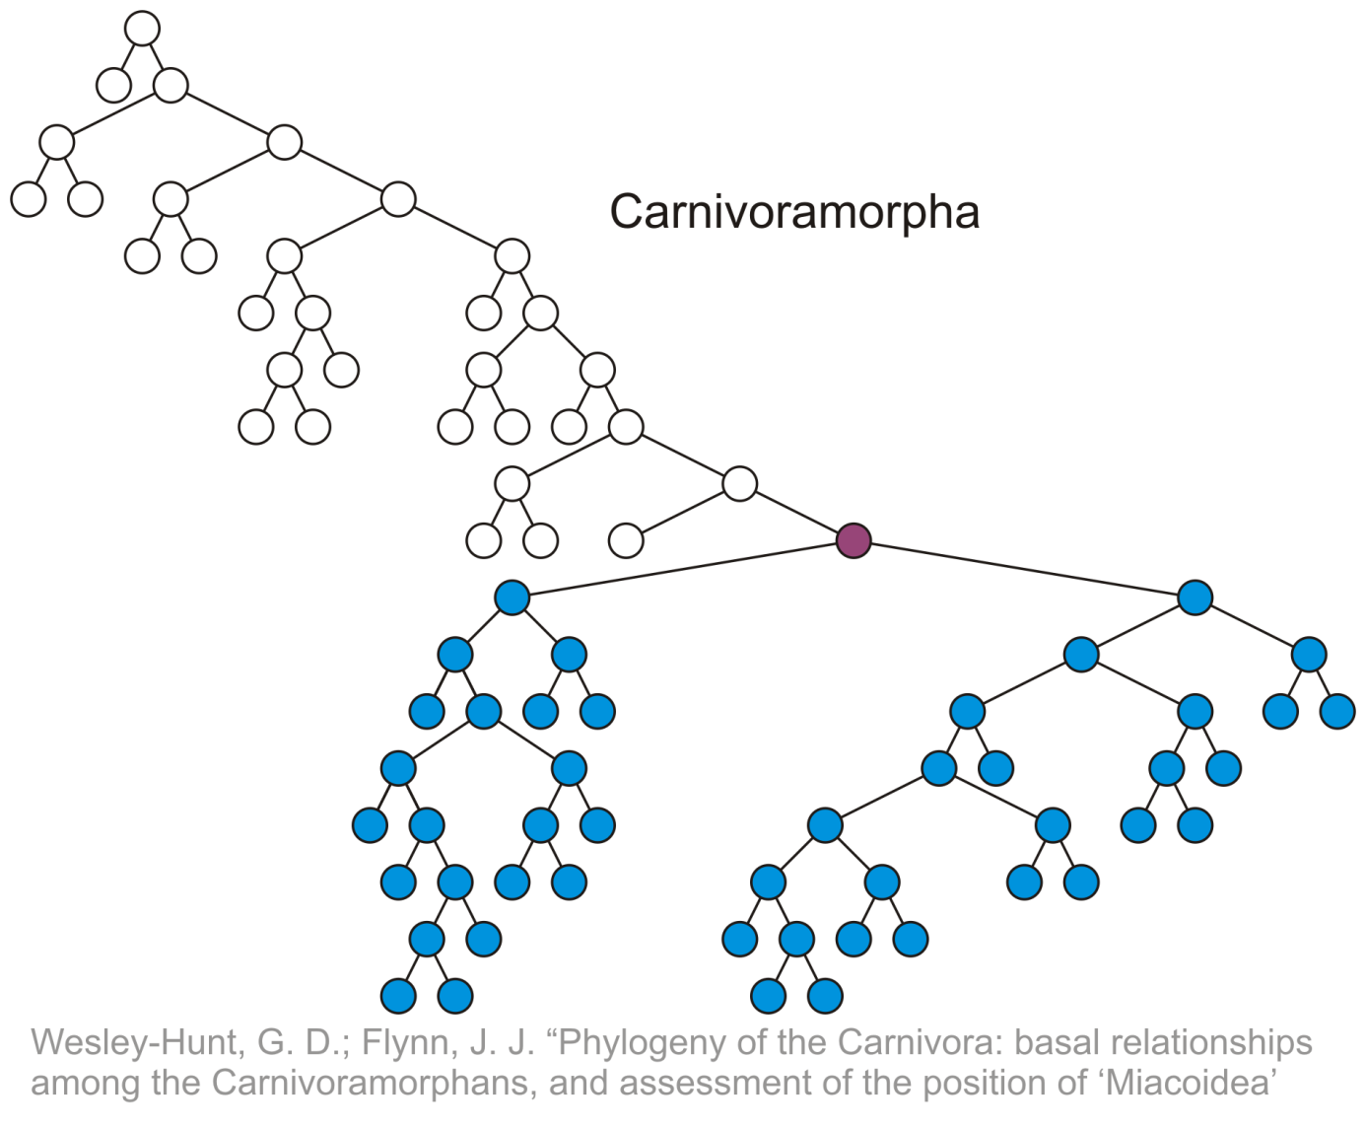
Trees
All descendants (including itself) of the indicated node
All ancestors (including itself) of the indicated node

Slide 17
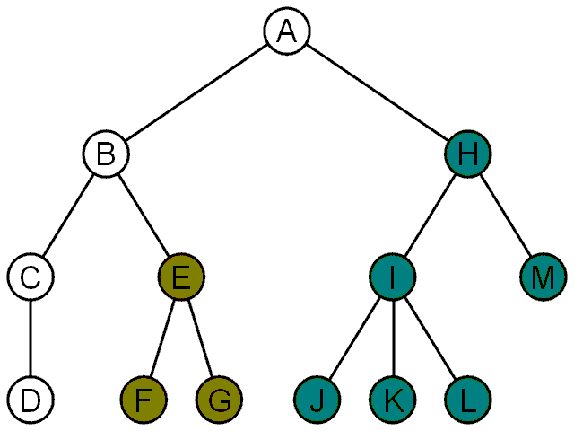
Trees
Another approach to a tree is to define the tree recursively:
A degree-0 node is a tree
A node with degree n is a tree if it has n children and all of its children are disjoint trees (i.e., with no intersecting nodes)
Given any node a within a tree with root r, the collection of a and all of its descendants is said to be a subtree of the tree with root a

Slide 18
Trees
Examples

Slide 19
Example: XHTML
The XML of XHTML has a tree structure
Cascading Style Sheets (CSS) use the tree structure to modify the display of HTML
Consider the following XHTML document
<html>
<head>
<title>Hello World!</title>
</head>
<body>
<h1>This is a <u>Heading</u></h1>
<p>This is a paragraph with some
<u>underlined</u> text.</p>
</body>
</html>
Consider the following XHTML document
<html>
<head>
<title>Hello World!</title>
</head>
<body>
<h1>This is a <u>Heading</u></h1>
<p>This is a paragraph with some
<u>underlined</u> text.</p>
</body>
</html>
title
heading
underlining
body of page
paragraph

Slide 20
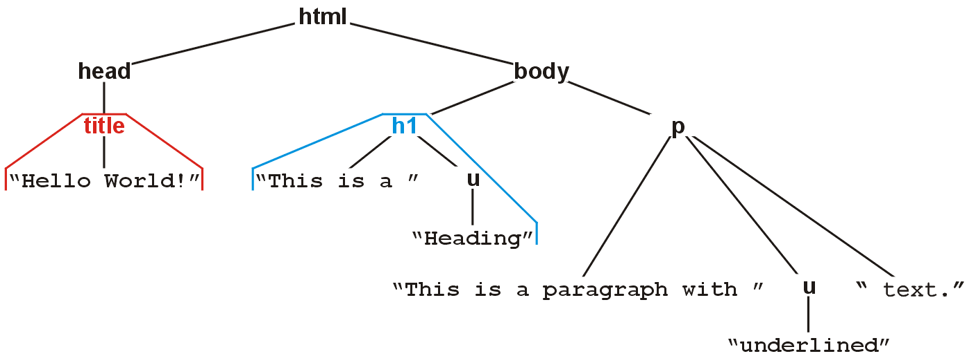

Example: XHTML

Slide 21
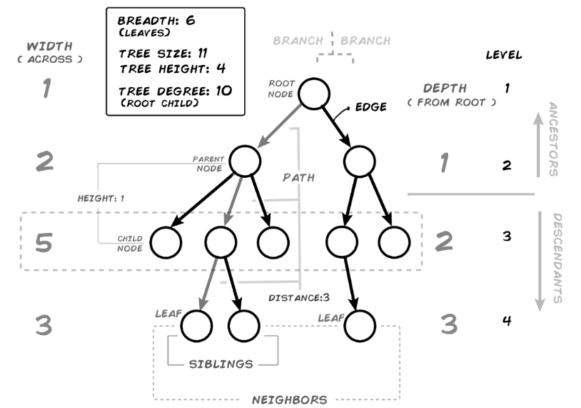
Trees

Slide 22
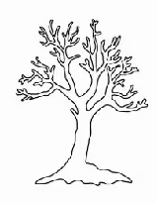
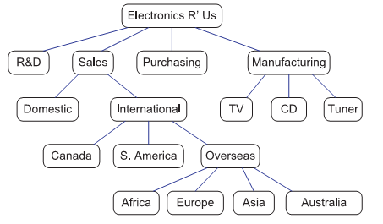
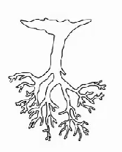
Trees

Slide 23
Trees
Traversal

Slide 24
Trees
List of a tree's nodes is called a traversal if it lists each tree node exactly once.
Traversal is a process to visit all the nodes of a tree and may print their values.
A traversal of a tree T is a systematic way of accessing, or “visiting,” all the nodes
The three most commonly used traversal orders are recursively described as:
Inorder: traverse left subtree, visit current node, traverse right subtree
Postorder: traverse left subtree, traverse right subtree, visit current node
Preorder: visit current node, traverse left subtree, traverse right subtree

